Slide 1
Lesson objective
Need whiteboards and calculators.
Test Friday!
Title: Notes page
Aim:
Set up a notes page to help our test.
Plan:
Review PAV
inverse
Notes page

Slide 2
Inverse
Solve the missing blanks (on your whiteboards)
5 x ____ = 25
3 x ____ = 18
10 x ____ = 100

Slide 3


Inverse problems
Tom knows his lawn is ${32m}^{2}$. He also knows it is rectangular is shape and 8m long. How wide is Tom’s lawn?
8m
? m
$${32m}^{2}$$

Slide 4


Inverse triangles
How can we find the height of this triangle?
Area formula:
$$A=b ×h ÷2$$
$$A=20 × ? ÷2=50$$
$$h= ?$$
$${50m}^{2}$$
20m

Slide 5



Inverse
Sketch these triangles and label, then solve the height of these triangles (exercise books).
$${20m}^{2}$$
$${100m}^{2}$$
$${10m}^{2}$$
8m
5m
10m

Slide 6
Notes page start
Define Perimeter :
Perimeter is the total distance forming the boundary of the shape.
Units:
mm, cm, m, Km

Slide 7

Area
Define area:
The amount of space inside a closed shape
Units:
- $mm^{2}, cm^{2}, m^{2}, Km^{2}$

Slide 8
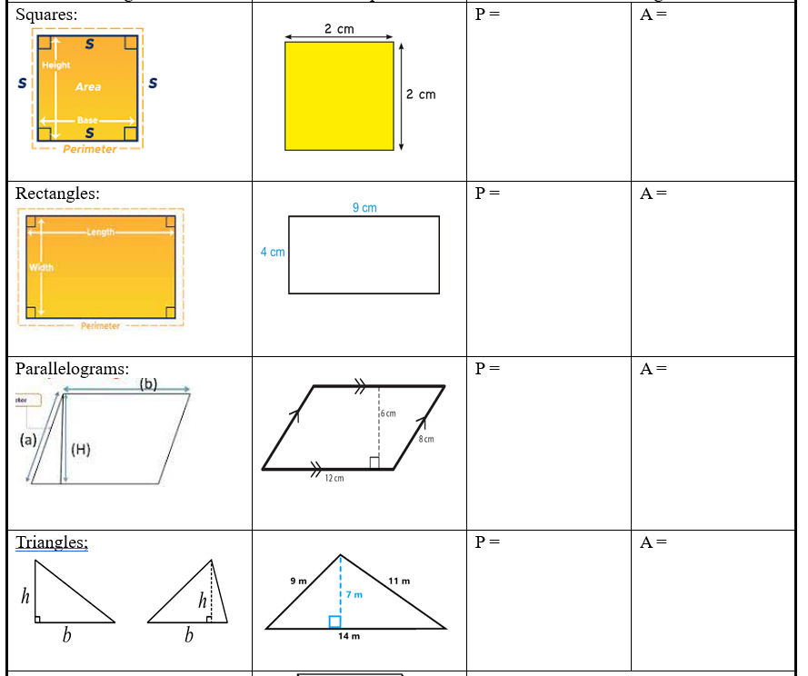

Slide 9

Volume
Define volume:
the amount of space that a substance or object occupies, or that is enclosed within a container.
Units:
- $mm^{3}, cm^{3}, m^{3}, km^{3}$

Slide 10
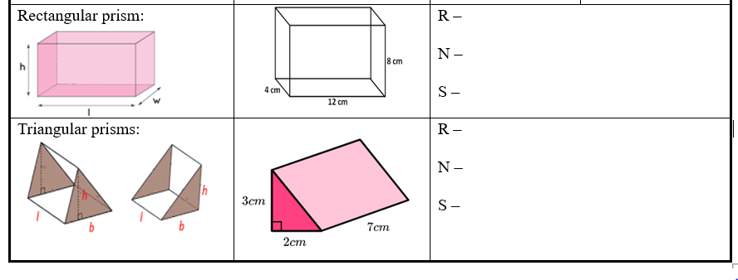

Slide 11
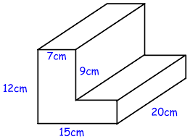
Calculate volume:

Slide 12
Textbook practice
Page 469
Questions 1 - 9

